Slide 1
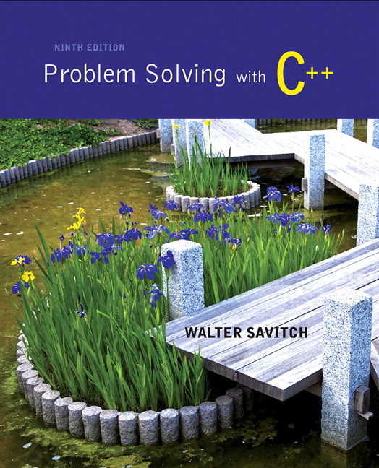
Problem Solving with C++ by Walter Savitch

Slide 2
Chapter 3
More Flow of Control

Slide 3
Overview
3.1 Using Boolean Expressions
3.2 Multiway Branches
3.3 More about C++ Loop Statements
3.4 Designing Loops

Slide 4
Flow Of Control
Flow of control refers to the order in which program statements are performed
We have seen the following ways to specify flow of control
if-else-statements
while-statements
do-while-statements
New methods described in this chapter include
switch-statements
for-statements

Slide 5
3.1
Using Boolean Expressions

Slide 6
Using Boolean Expressions
A Boolean Expression is an expression that is either true or false
Boolean expressions are evaluated using relational operations such as
= = , < , and >= which produce a boolean value
and boolean operations such as
&&, | |, and ! which also produce a boolean value
Type bool allows declaration of variables that carry the value true or false

Slide 7
Evaluating Boolean Expressions
Boolean expressions are evaluated using values from the Truth Tables in
For example, if y is 8, the expression !( ( y < 3) | | ( y > 7) ) is evaluated in the following sequence
! ( false | | true )
! ( true )
false
Display 3.1

Slide 8
Order of Precedence
If parenthesis are omitted from boolean expressions, the default precedence of operations is:
Perform ! operations first
Perform relational operations such as < next
Perform && operations next
Perform | | operations last

Slide 9
Precedence Rules
Items in expressions are grouped by precedence rules for arithmetic and boolean operators
Operators with higher precedence are performed first
Binary operators with equal precedence are performed left to right
Unary operators of equal precedence are performed right to left
Display 3.2

Slide 10
Precedence Rule Example
The expression (x+1) > 2 | | (x + 1) < -3 is equivalent to ( (x + 1) > 2) | | ( ( x + 1) < -3)
Because > and < have higher precedence than | |
and is also equivalent to x + 1 > 2 | | x + 1 < - 3

Slide 11
Evaluating x + 1 > 2 | | x + 1 < - 3
Using the precedence rules of Display 3.2
First apply the unary –
Next apply the +'s
Now apply the > and <
Finally do the | |

Slide 12
Short-Circuit Evaluation
Some boolean expressions do not need to be completely evaluated
if x is negative, the value of the expression (x >= 0) && ( y > 1) can be determined by evaluating only (x >= 0)
C++ uses short-circuit evaluation
If the value of the leftmost sub-expression determines the final value of the expression, the rest of the expression is not evaluated

Slide 13
Using Short-Circuit Evaluation
Short-circuit evaluation can be used to prevent run time errors
Consider this if-statement if ((kids != 0) && (pieces / kids >= 2) ) cout << "Each child may have two pieces!";
If the value of kids is zero, short-circuit evaluation prevents evaluation of (pieces / 0 >= 2)
Division by zero causes a run-time error

Slide 14
Type bool and Type int
C++ can use integers as if they were Boolean values
Any non-zero number (typically 1) is true
0 (zero) is false

Slide 15
Problems with !
The expression ( ! time > limit ), with limit = 60, is evaluated as (!time) > limit
If time is an int with value 36, what is !time?
False! Or zero since it will be compared to an integer
The expression is further evaluated as 0 > limit
false

Slide 16
Correcting the ! Problem
The intent of the previous expression was most likely the expression ( ! ( time > limit) ) which evaluates as ( ! ( false) ) true

Slide 17
Avoiding !
Just as not in English can make things not undifficult to read, the ! operator can make C++ expressions difficult to understand
Before using the ! operator see if you can express the same idea more clearly without the ! operator

Slide 18
Enumeration Types (Optional)
An enumeration type is a type with values defined by a list of constants of type int
Example:
enum MonthLength{JAN_LENGTH = 31, FEB_LENGTH = 28, MAR_LENGTH = 31, … DEC_LENGTH = 31};

Slide 19
Default enum Values
If numeric values are not specified, identifiers are assigned consecutive values starting with 0
enum Direction { NORTH = 0, SOUTH = 1, EAST = 2, WEST = 3}; is equivalent to enum Direction {NORTH, SOUTH, EAST, WEST};

Slide 20
Enumeration Values
Unless specified, the value assigned an enumeration constant is 1 more than the previous constant
enum MyEnum{ONE = 17, TWO, THREE, FOUR = -3, FIVE}; results in these values
ONE = 17, TWO = 18, THREE = 19, FOUR = -3, FIVE = -2

Slide 21

Strong Enums
C++11 introduced a new version of enumeration called strong enums or enum classes that avoids some problems of conventional enums
May not want an enum to act like an int
Enums are global so you can’t have the same enum value twice
Define a strong enum as follows:

Slide 22
Using Strong Enums
To use our strong enums:
Days d = Days::Tue;
Weather w = Weather::Sun;
The variables d and w are not integers so we can’t treat them as such.

Slide 23
Section 3.1 Conclusion
Can you
Write a function definition for a function named in_order that takes three arguments of type int? The function returns true if the arguments are in ascending order; otherwise, it returns false.
Determine the value of these Boolean expressions?
Assume count = 0 and limit = 10
(count == 0) && (limit < 20)
!(count == 12)
(limit < 0) && ((limit /count) > 7)

Slide 24
3.2
Multiway Branches

Slide 25
Multiway Branches
A branching mechanism selects one out of a number of alternative actions
The if-else-statement is a branching mechanism
Branching mechanisms can be a subpart of another branching mechanism
An if-else-statement can include another if-else-statement as a subpart

Slide 26
Nested Statements
A statement that is a subpart of another statement is a nested statement
When writing nested statements it is normal to indent each level of nesting
Example: if (count < 10) if ( x < y) cout << x << " is less than " << y; else cout << y << " is less than " << x;
indented
Display 3.3

Slide 27
Nested if-else Statements
Use care in nesting if-else-statements
Example: To design an if-else statement to warn a driver when fuel is low, but tells the driver to bypass pit stops if the fuel is close to full. Other wise there should be no output. Pseudocode: if fuel gauge is below ¾ then: if fuel gauge is below ¼ then: issue a warning otherwise (gauge > ¾) then: output a statement saying don't stop

Slide 28
First Try Nested if's
Translating the previous pseudocode to C++ could yield (if we are not careful) if (fuel_gauge_reading < 0.75) if (fuel_gauge_reading < 0.25) cout << "Fuel very low. Caution!\n"; else cout << "Fuel over 3/4. Don't stop now!\n";
This would compile and run, but does not produce the desired results
The compiler pairs the "else" with the nearest previous "if"

Slide 29
Braces and Nested Statements
Braces in nested statements are like parenthesis in arithmetic expressions
Braces tell the compiler how to group things
Use braces around substatements
demonstrates the use of braces in nested if-else-statements
Display 3.4

Slide 30
Multi-way if-else-statements
An if-else-statement is a two-way branch
Three or four (or more) way branches can be designed using nested if-else-statements
Example: The number guessing game with the number stored in variable number, the guess in variable guess. How do we give hints?

Slide 31
Number Guessing
The following nested statements implement the hints for our number guessing game
if (guess> number) cout << "Too high."; else if (guess < number) cout << "Too low."); else if (guess == number) cout << "Correct!";

Slide 32
Indenting Nested if-else
Notice how the code on the previous slide crept across the page leaving less and less space
Use this alternative for indenting several nested if-else-statements: if (guess> number) cout << "Too high."; else if (guess < number) cout << "Too low."); else if (guess == number) cout << "Correct!";

Slide 33
The Final if-else-statement
When the conditions tested in an if-else-statement are mutually exclusive, the final if-else can sometimes be omitted.
The previous example can be written as
if (guess> number) cout << "Too high."; else if (guess < number) cout << "Too low."); else // (guess == number) cout << "Correct!";

Slide 34
Nested if-else Syntax
A Multiway if-else statement is written as
if(Boolean_Expression_1) Statement_1 else if ( Boolean_Expression_2) Statement_2 … else if (Boolean_Expression_n) Statement _n else Statement_For_All_Other_Possibilities

Slide 35
Program Example: State Income Tax
Write a program for a state that computes tax according to the rate schedule: No tax on first $15,000 of income 5% tax on each dollar from $15,001 to $25,000 10% tax on each dollar over $25,000
Display 3.5 (1)
Display 3.5 (2)

Slide 36
Refining if-else-statements
Notice that the line else if (( net_income > 15000 && net_income < = 25000)) can be replaced with else if (net_income <= 25000)
The computer will not get to this line unless it is already determined that net_income > 15000

Slide 37
The switch-statement
The switch-statement is an alternative for constructing multi-way branches
The example in Display 3.6 determines output based on a letter grade
Grades 'A', 'B', and 'C' each have a branch
Grades 'D' and 'F' use the same branch
If an invalid grade is entered, a default branch is used
Display 3.6 (1)
Display 3.6 (2)

Slide 38
switch-statement Syntax
switch (controlling expression) { case Constant_1: statement_Sequence_1 break; case Constant_2: Statement_Sequence_2 break; . . . case Constant_n: Statement_Sequence_n break; default: Default_Statement_Sequence }

Slide 39
The Controlling Statement
A switch statement's controlling statement must return one of these types
A bool value
An enum constant
An integer type
A character
The value returned is compared to the constant values after each "case"
When a match is found, the code for that case is used

Slide 40
The break Statement
The break statement ends the switch-statement
Omitting the break statement will cause the code for the next case to be executed!
Omitting a break statement allows the use of multiple case labels for a section of code
case 'A': case 'a': cout << "Excellent."; break;
Runs the same code for either 'A' or 'a'

Slide 41
The default Statement
If no case label has a constant that matches the controlling expression, the statements following the default label are executed
If there is no default label, nothing happens when the switch statement is executed
It is a good idea to include a default section

Slide 42
Switch-statements and Menus
Nested if-else statements are more versatile than a switch statement
Switch-statements can make some code more clear
A menu is a natural application for a switch-statement
Display 3.7 (1)
Display 3.7 (2)

Slide 43
Function Calls in Branches
Switch and if-else-statements allow the use of multiple statements in a branch
Multiple statements in a branch can make the switch or if-else-statement difficult to read
Using function calls (as shown in Display 3.7) instead of multiple statements can make the switch or if-else-statement much easier to read

Slide 44
Blocks
Each branch of a switch or if-else statement is a separate sub-task
If the action of a branch is too simple to warrant a function call, use multiple statements between braces
A block is a section of code enclosed by braces
Variables declared within a block, are local to the block or have the block as their scope.
Variable names declared in the block can be reused outside the block
Display 3.8 (1)
Display 3.8 (2)

Slide 45
Statement Blocks
A statement block is a block that is not a function body or the body of the main part of a program
Statement blocks can be nested in other statement blocks
Nesting statement blocks can make code difficult to read
It is generally better to create function calls than to nest statement blocks

Slide 46
Scope Rule for Nested Blocks
If a single identifier is declared as a variable in each of two blocks, one within the other, then these are two different variables with the same name
One of the variables exists only within the inner block and cannot be accessed outside the inner block
The other variable exists only in the outer block and cannot be accessed in the inner block

Slide 47
Section 3.2 Conclusion
Can you
Give the output of this code fragment? { int x = 1; cout << x << endl; { cout << x << endl; int x = 2; cout << x << endl; } cout << x << endl;

Slide 48
3.3
More About C++ Loop
Statements

Slide 49
More About C++ Loop Statements
A loop is a program construction that repeats a statement or sequence of statements a number of times
The body of the loop is the statement(s) repeated
Each repetition of the loop is an iteration
Loop design questions:
What should the loop body be?
How many times should the body be iterated?

Slide 50
while and do-while
An important difference between while and do-while loops:
A while loop checks the Boolean expression at the beginning of the loop
A while loop might never be executed!
A do-while loop checks the Boolean expression at the end of the loop
A do-while loop is always executed at least once
Review while and do-while syntax in
Display 3.9

Slide 51
The Increment Operator
We have used the increment operator in statements such as number++; to increase the value of number by one
The increment operator can also be used in expressions: int number = 2; int value_produced = 2 * (number++);
(number++) first returns the value of number (2) to be multiplied by 2, then increments number to three

Slide 52
number++ vs ++number
(number++) returns the current value of number, then increments number
An expression using (number++) will use the value of number BEFORE it is incremented
(++number) increments number first and returns the new value of number
An expression using (++number) will use the value of number AFTER it is incremented
Number has the same value after either version!

Slide 53
++ Comparisons
int number = 2; int value_produced = 2 * (number++); cout << value_produced << " " << number; displays 4 3
int number = 2; int value_produced = 2* (++number); cout << value_produced << " " number; displays 6 3
Display 3.10

Slide 54
The Decrement Operator
The decrement operator (--) decreases the value of the variable by one
int number = 8; int value_produced = number--; cout << value_produced << " " << number; displays 8 7
Replacing "number--" with "--number" displays 7 7

Slide 55
The for-Statement
A for-Statement (for-loop) is another loop mechanism in C++
Designed for common tasks such as adding numbers in a given range
Is sometimes more convenient to use than a while loop
Does not do anything a while loop cannot do

Slide 56
for/while Loop Comparison
sum = 0; n = 1; while(n <= 10) // add the numbers 1 - 10 { sum = sum + n; n++; }
sum = 0; for (n = 1; n <= 10; n++) //add the numbers 1 - 10 sum = sum + n;

Slide 57
For Loop Dissection
The for loop uses the same components as the while loop in a more compact form
for (n = 1; n <= 10; n++)
Initialization Action
Update Action
Boolean Expression

Slide 58
for Loop Alternative
A for loop can also include a variable declaration in the initialization action
for (int n = 1; n < = 10; n++) This line means
Create a variable, n, of type int and initialize it with 1
Continue to iterate the body as long as n <= 10
Increment n by one after each iteration
For-loop syntax and while loop comparison are found in
Display 3.11

Slide 59
For-loop Details
Initialization and update actions of for-loops often contain more complex expressions
Here are some samples
for (n = 1; n < = 10; n = n + 2) for(n = 0 ; n > -100 ; n = n -7)
for(double x = pow(y,3.0); x > 2.0; x = sqrt(x) )

Slide 60
The for-loop Body
The body of a for-loop can be
A single statement
A compound statement enclosed in braces
Example: for(int number = 1; number >= 0; number--) { // loop body statements }
shows the syntax for a for-loop with a multi-statement body
Display 3.13

Slide 61
The Empty Statement
A semicolon creates a C++ statement
Placing a semicolon after x++ creates the statement x++;
Placing a semicolon after nothing creates an empty statement that compiles but does nothing cout << "Hello" << endl; ; cout << "Good Bye"<< endl;

Slide 62
Extra Semicolon
Placing a semicolon after the parentheses of a for loop creates an empty statement as the body of the loop
Example: for(int count = 1; count <= 10; count++); cout << "Hello\n"; prints one "Hello", but not as part of the loop!
The empty statement is the body of the loop
cout << "Hello\n"; is not part of the loop body!

Slide 63
Local Variable Standard
ANSI C++ standard requires that a variable declared in the for-loop initialization section be local to the block of the for-loop
Find out how your compiler treats these variables!
If you want your code to be portable, do not depend on all compilers to treat these variables as local to the for-loop!

Slide 64
Which Loop To Use?
Choose the type of loop late in the design process
First design the loop using pseudocode
Translate the pseudocode into C++
The translation generally makes the choice of an appropriate loop clear
While-loops are used for all other loops when there might be occassions when the loop should not run
Do-while loops are used for all other loops when the loop must always run at least once

Slide 65
Choosing a for-loop
for-loops are typically selected when doing numeric calculations, especially when using a variable changed by equal amounts each time the loop iterates

Slide 66
Choosing a while-loop
A while-loop is typically used
When a for-loop is not appropriate
When there are circumstances for which the loop body should not be executed at all

Slide 67
Choosing a do-while Loop
A do-while-loop is typically used
When a for-loop is not appropriate
When the loop body must be executed at least once

Slide 68
The break-Statement
There are times to exit a loop before it ends
If the loop checks for invalid input that would ruin a calculation, it is often best to end the loop
The break-statement can be used to exit a loop before normal termination
Be careful with nested loops! Using break only exits the loop in which the break-statement occurs
Display 3.14

Slide 69
Section 3.3 Conclusion
Can you
Determine the output of the following? for(int count = 1; count < 5; count++) cout << (2 * count) << " " ;
Determine which type of loop is likely to be best for
Summing a series such as 1/2 + 1/3 + 1/4 + … + 1/10?
Reading a list of exam scores for one student?
Testing a function to see how it performs with different values of its arguments

Slide 70
3.4
Designing Loops

Slide 71
Designing Loops
Designing a loop involves designing
The body of the loop
The initializing statements
The conditions for ending the loop

Slide 72
Sums and Products
A common task is reading a list of numbers and computing the sum
Pseudocode for this task might be: sum = 0; repeat the following this_many times cin >> next; sum = sum + next; end of loop
This pseudocode can be implemented with a for-loop as shown on the next slide

Slide 73
for-loop for a sum
The pseudocode from the previous slide is implemented as int sum = 0; for(int count=1; count <= this_many; count++) { cin >> next; sum = sum + next; }
sum must be initialized prior to the loop body!

Slide 74
Repeat "this many times"
Pseudocode containing the line repeat the following "this many times" is often implemented with a for-loop
A for-loop is generally the choice when there is a predetermined number of iterations
Example: for(int count = 1; count <= this_many; count++) Loop_body

Slide 75
for-loop For a Product
Forming a product is very similar to the sum example seen earlier int product = 1; for(int count=1; count <= this_many; count++) { cin >> next; product = product * next; }
product must be initialized prior to the loop body
Notice that product is initialized to 1, not 0!

Slide 76
Ending a Loop
The are four common methods to terminate an input loop
List headed by size
When we can determine the size of the list beforehand
Ask before iterating
Ask if the user wants to continue before each iteration
List ended with a sentinel value
Using a particular value to signal the end of the list
Running out of input
Using the eof function to indicate the end of a file

Slide 77
List Headed By Size
The for-loops we have seen provide a natural implementation of the list headed by size method of ending a loop
Example: int items; cout << "How many items in the list?"; cin >> items; for(int count = 1; count <= items; count++) { int number; cout << "Enter number " << count; cin >> number; cout << endl; // statements to process the number }

Slide 78
Ask Before Iterating
A while loop is used here to implement the ask before iterating method to end a loop sum = 0; cout << "Are there numbers in the list (Y/N)?"; char ans; cin >> ans; while (( ans = 'Y') || (ans = 'y')) { //statements to read and process the number cout << "Are there more numbers(Y/N)? "; cin >> ans; }

Slide 79
List Ended With a Sentinel Value
A while loop is typically used to end a loop using the list ended with a sentinel value method cout << "Enter a list of nonnegative integers.\n" << "Place a negative integer after the list.\n"; sum = 0; cin >> number; while (number > 0) { //statements to process the number cin >> number; }
Notice that the sentinel value is read, but not processed

Slide 80
Running Out of Input
The while loop is typically used to implement the running out of input method of ending a loop ifstream infile; infile.open("data.dat"); while (! infile.eof( ) ) { // read and process items from the file // File I/O covered in Chapter 6 } infile.close( );

Slide 81
General Methods To Control Loops
Three general methods to control any loop
Count controlled loops
Ask before iterating
Exit on flag condition

Slide 82
Count Controlled Loops
Count controlled loops are loops that determine the number of iterations before the loop begins
The list headed by size is an example of a count controlled loop for input

Slide 83
Exit on Flag Condition
Loops can be ended when a particular flag condition exists
A variable that changes value to indicate that some event has taken place is a flag
Examples of exit on a flag condition for input
List ended with a sentinel value
Running out of input

Slide 84
Exit on Flag Caution
Consider this loop to identify a student with a grade of 90 or better int n = 1; grade = compute_grade(n); while (grade < 90) { n++; grade = compute_grade(n); } cout << "Student number " << n << " has a score of " << grade << endl;

Slide 85
The Problem
The loop on the previous slide might not stop at the end of the list of students if no student has a grade of 90 or higher
It is a good idea to use a second flag to ensure that there are still students to consider
The code on the following slide shows a better solution

Slide 86
The Exit On Flag Solution
This code solves the problem of having no student grade at 90 or higher int n=1; grade = compute_grade(n); while (( grade < 90) && ( n < number_of_students)) { // same as before } if (grade > 90) // same output as before else cout << "No student has a high score.";

Slide 87
Nested Loops
The body of a loop may contain any kind of statement, including another loop
When loops are nested, all iterations of the inner loop are executed for each iteration of the outer loop
Give serious consideration to making the inner loop a function call to make it easier to read your program
Display 3.15 show two versions of a program with nested loops
Display 3.15

Slide 88
Debugging Loops
Common errors involving loops include
Off-by-one errors in which the loop executes one too many or one too few times
Infinite loops usually result from a mistake in the Boolean expression that controls the loop

Slide 89
Fixing Off By One Errors
Check your comparison: should it be < or <=?
Check that the initialization uses the correct value
Does the loop handle the zero iterations case?

Slide 90
Fixing Infinite Loops
Check the direction of inequalities: < or > ?
Test for < or > rather than equality (==)
Remember that doubles are really only approximations

Slide 91
More Loop Debugging Tips
Be sure that the mistake is really in the loop
Trace the variable to observe how the variable changes
Tracing a variable is watching its value change during execution
Many systems include utilities to help with this
cout statements can be used to trace a value

Slide 92
Debugging Example
The following code is supposed to conclude with the variable product containing the product of the numbers 2 through 5 int next = 2, product = 1; while (next < 5) { next++; product = product * next; }

Slide 93
Tracing Variables
Add temporary cout statements to trace variables int next = 2, product = 1; while (next < 5) { next++; product = product * next; cout << "next = " << next << "product = " << product << endl; }

Slide 94
First Fix
The cout statements added to the loop show us that the loop never multiplied by 2
Solve the problem by moving the statement next++ int next = 2, product = 1; while (next < 5) { product = product * next; next++; cout << "next = " << next << "product = " << product << endl; }
There is still a problem!

Slide 95
Second Fix
Re-testing the loop shows us that now the loop never multiplies by 5
The fix is to use <= instead of < in our comparison int next = 2, product = 1; while (next <= 5) { product = product * next; next++; }

Slide 96
Loop Testing Guidelines
Every time a program is changed, it must be retested
Changing one part may require a change to another
Every loop should at least be tested using input to cause:
Zero iterations of the loop body
One iteration of the loop body
One less than the maximum number of iterations
The maximum number of iteratons

Slide 97
Starting Over
Sometimes it is more efficient to throw out a buggy program and start over
The new program will be easier to read
The new program is less likely to be as buggy
You may develop a working program faster than if you repair the bad code
The lessons learned in the buggy code will help you design a better program faster

Slide 98
Chapter 3.4 Conclusion
Can you
Describe how to trace a variable?
List possible solutions to an off-by-one error?
Determine the number of fence posts needed for a 100 meter long fence?

Slide 99
Chapter 3 -- End

Slide 100
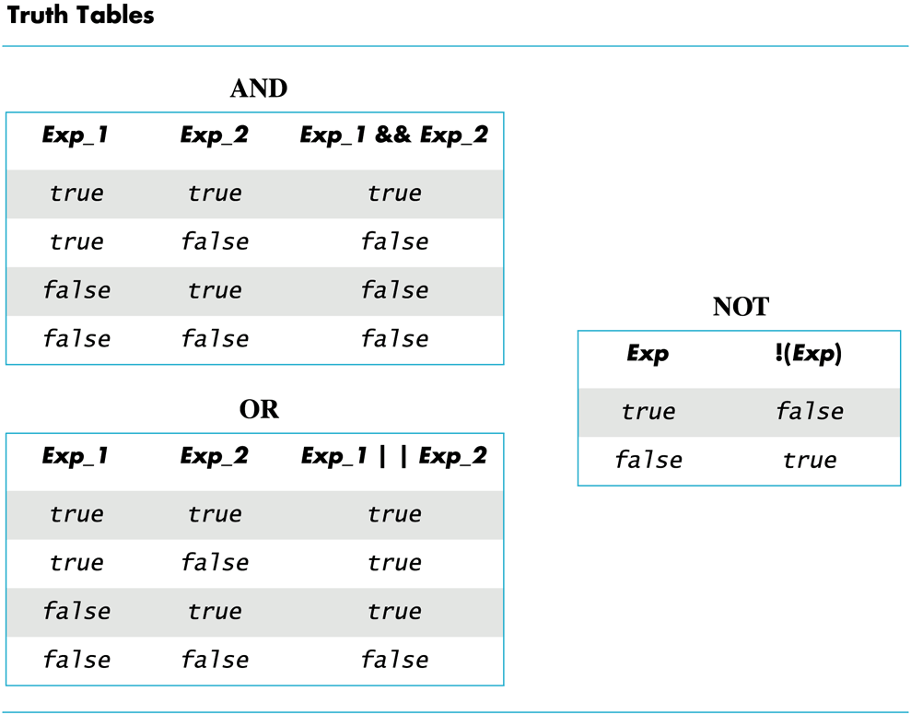
Display 3.1
Back
Next

Slide 101
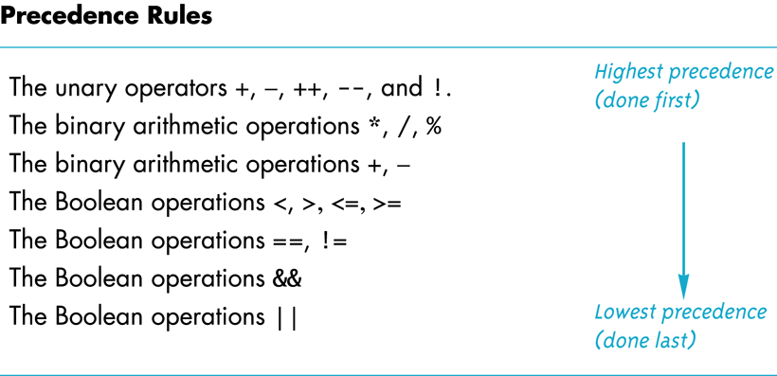
Display 3.2
Back
Next

Slide 102
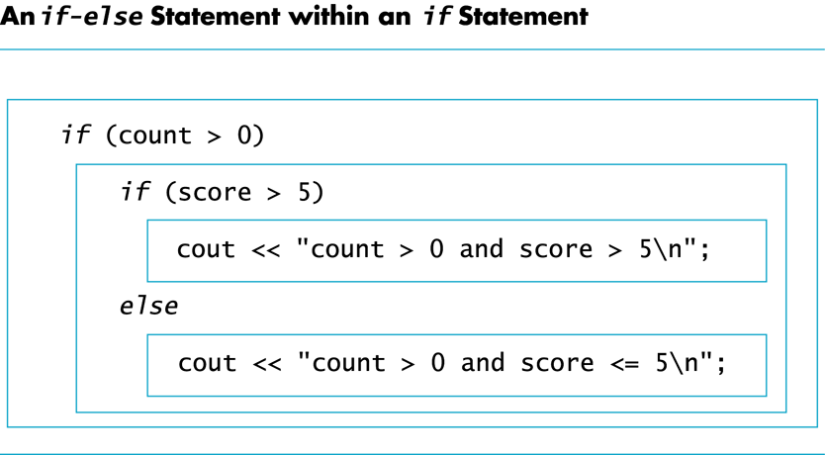
Display 3.3
Back
Next

Slide 103
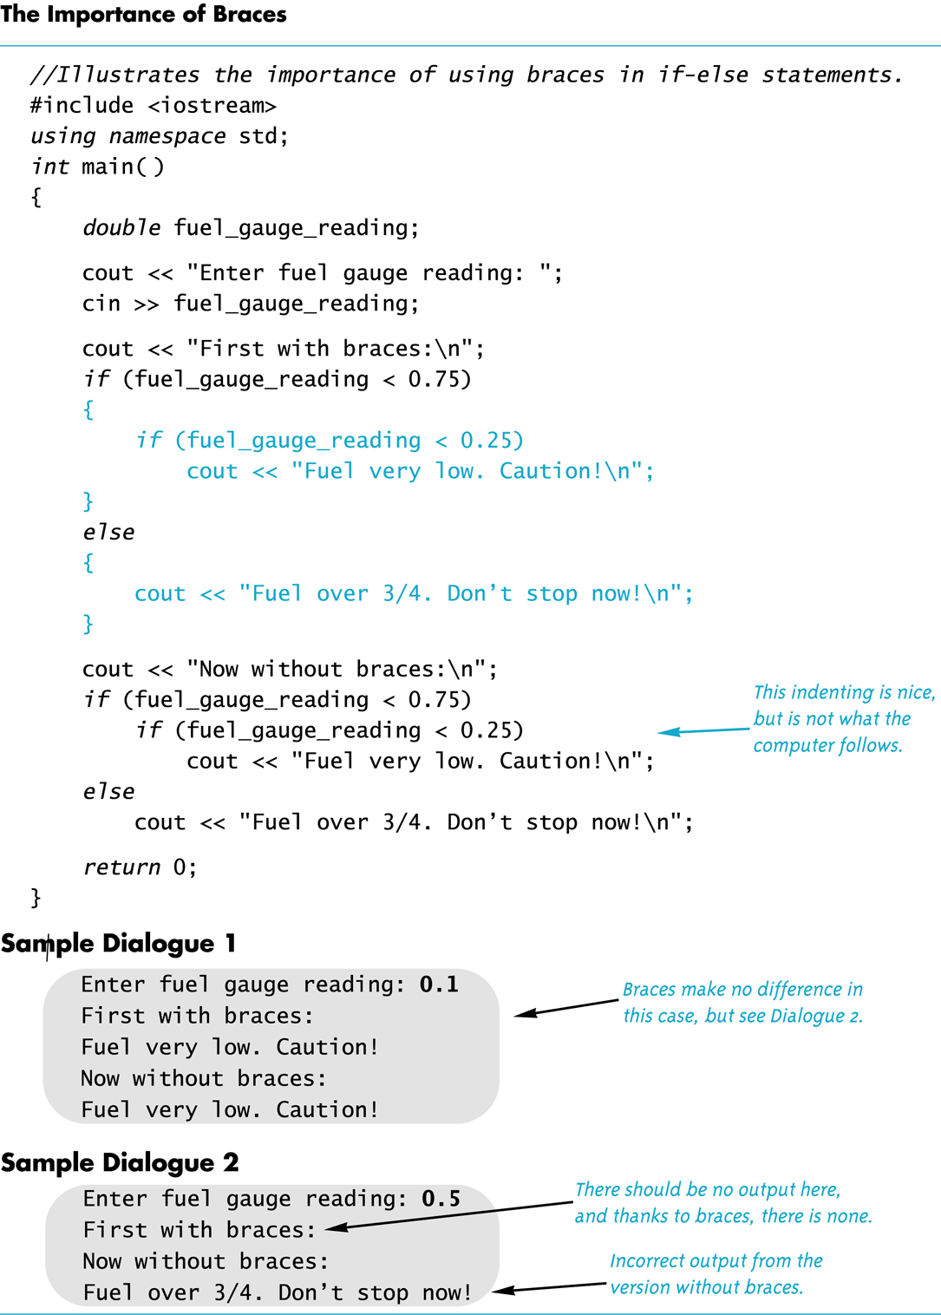
Display 3.4
Back
Next

Slide 104
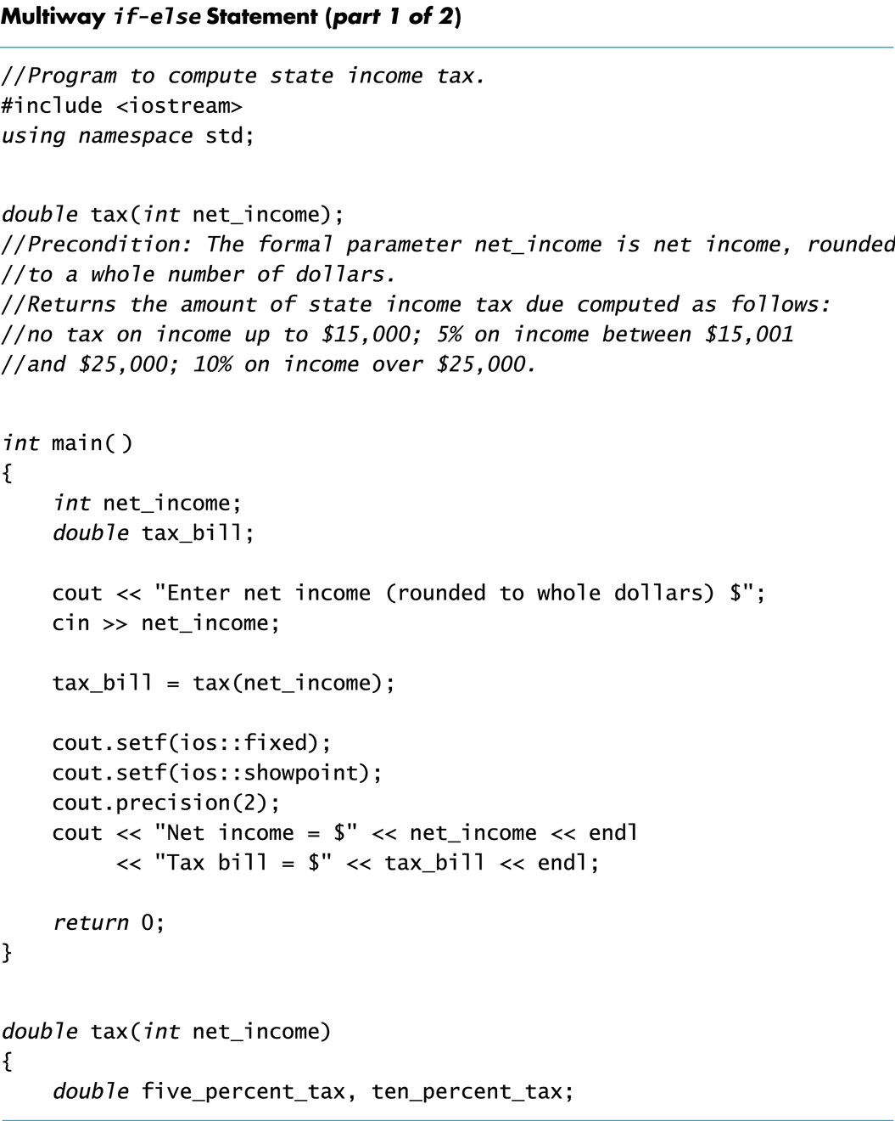
Display 3.5 (1/2)
Back
Next

Slide 105
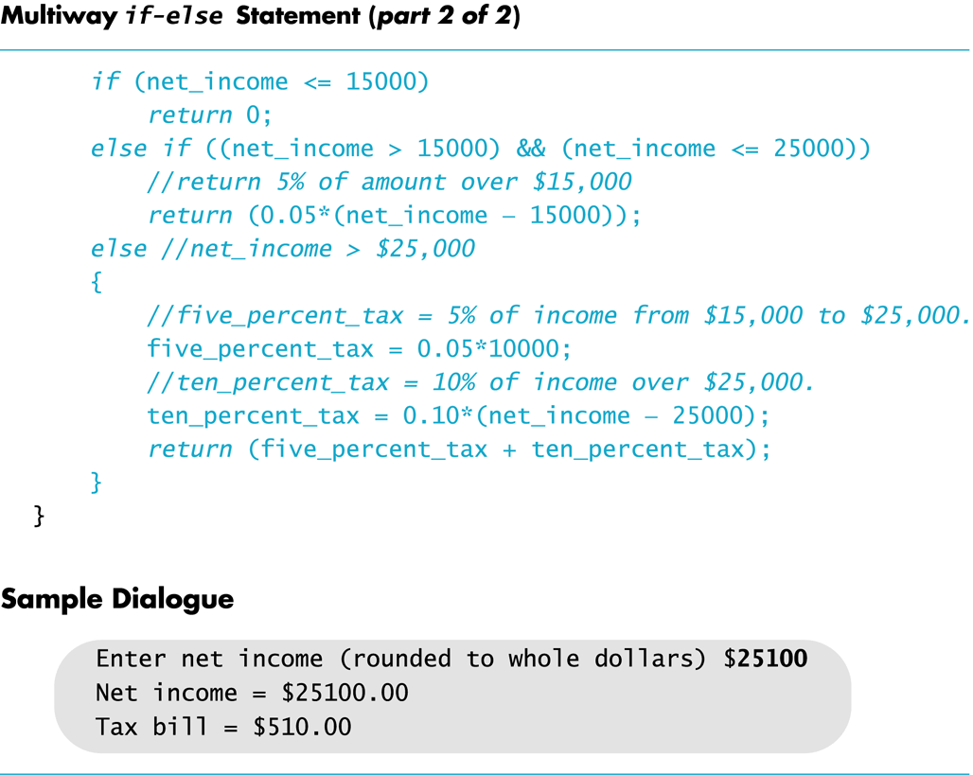
Display 3.5 (2/2)
Back
Next

Slide 106
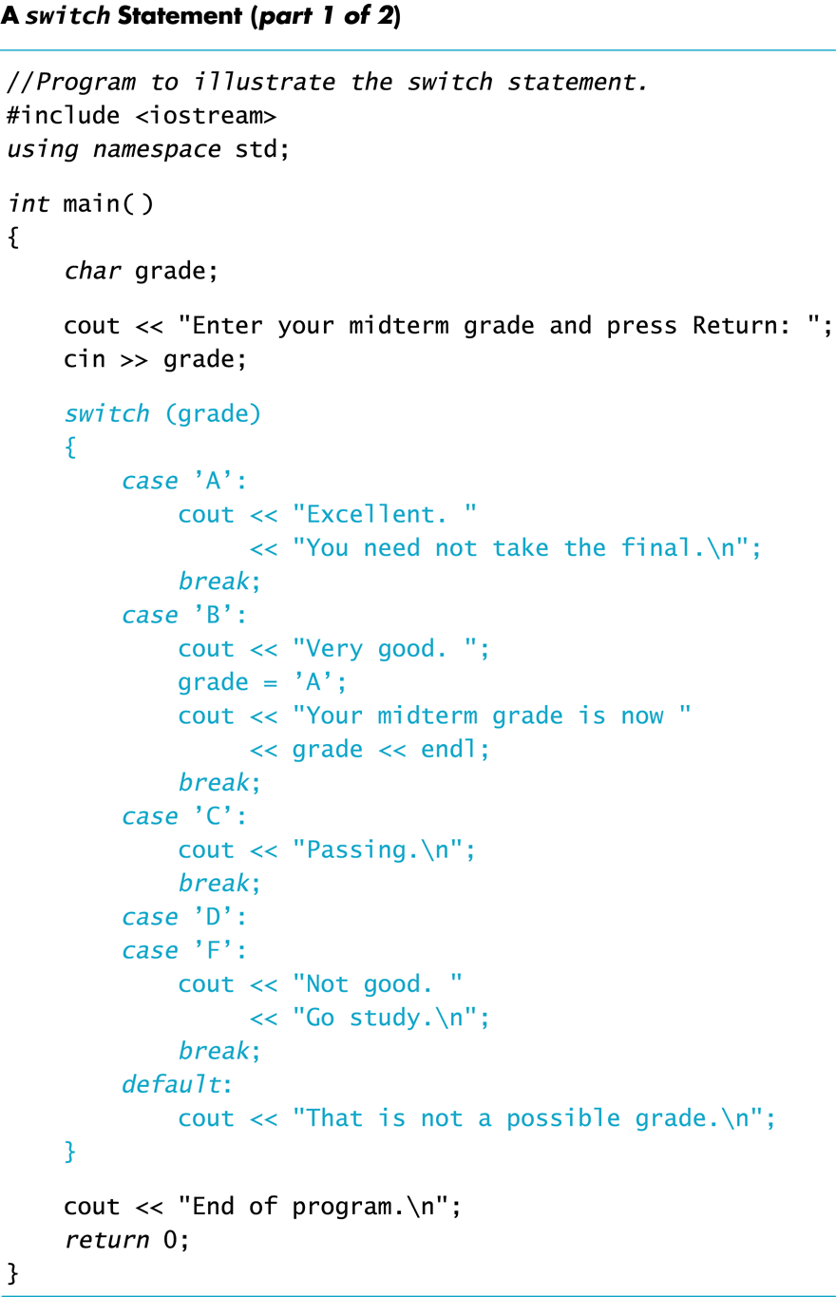
Display 3.6 (1/2)
Back
Next

Slide 107
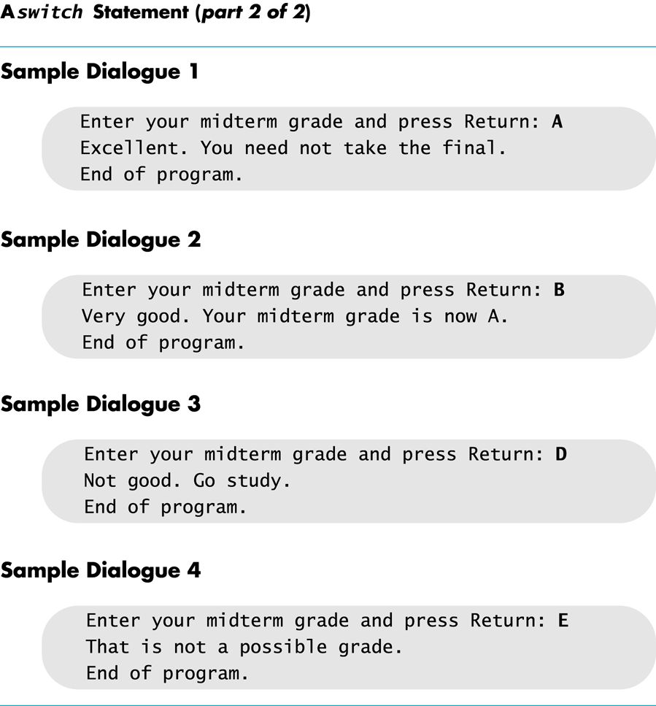
Display 3.6 (2/2)
Back
Next

Slide 108
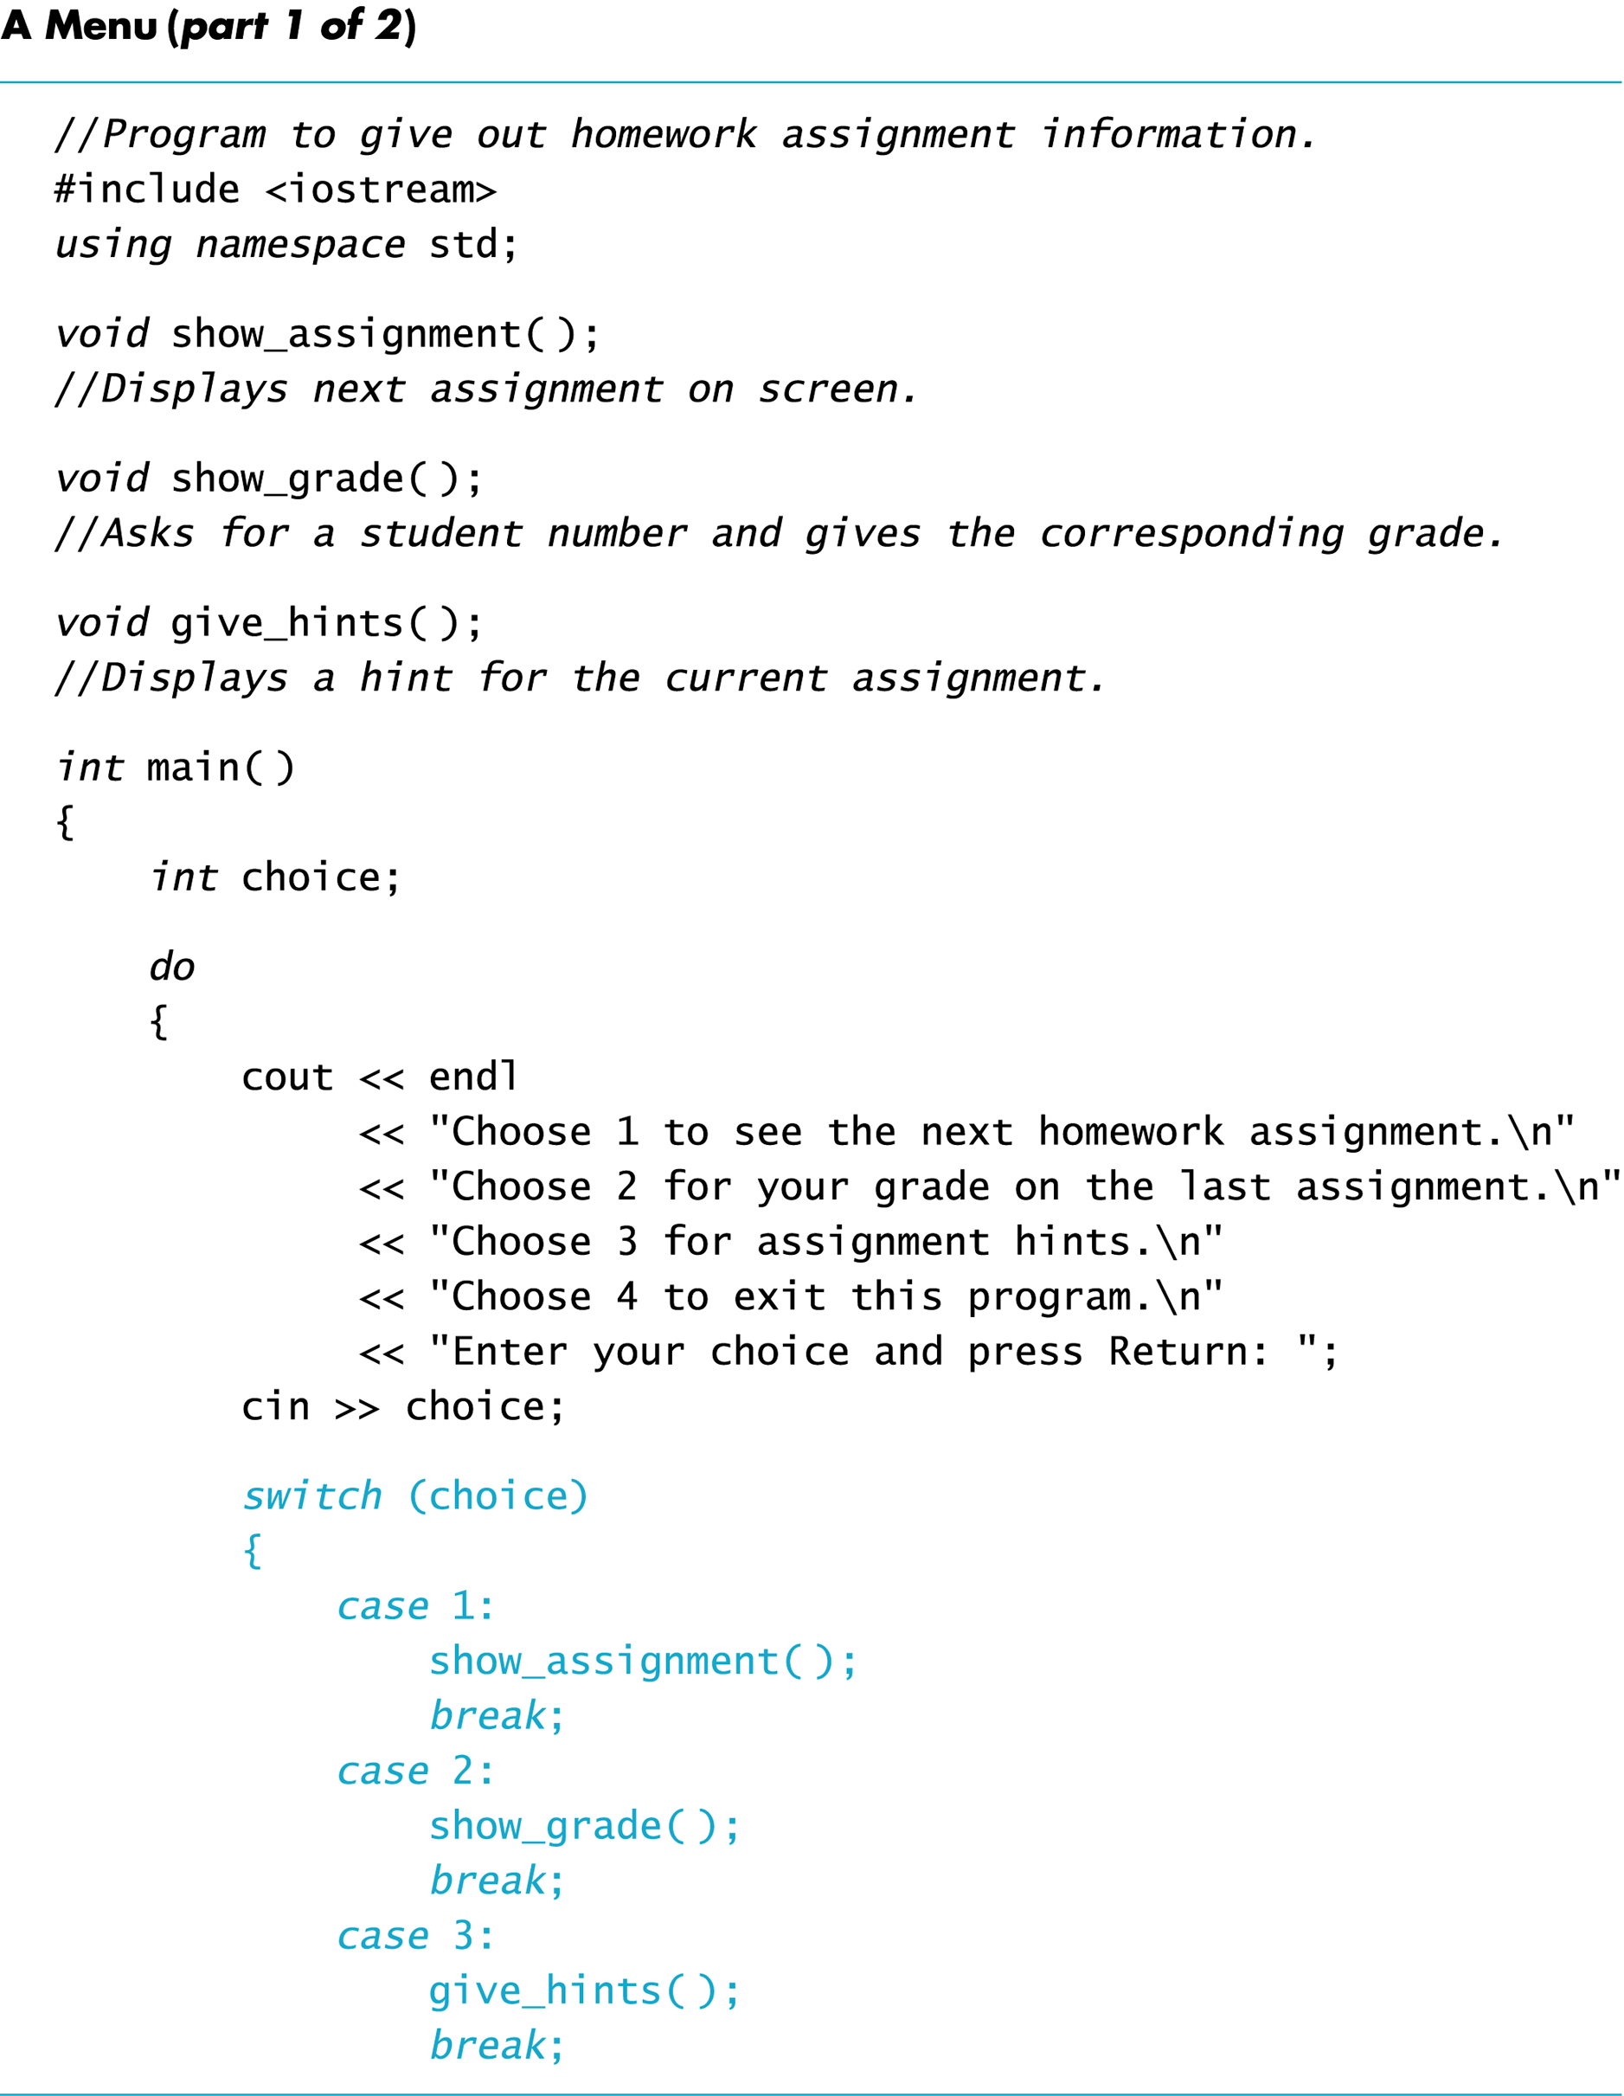
Display 3.7 (1/2)
Back
Next

Slide 109
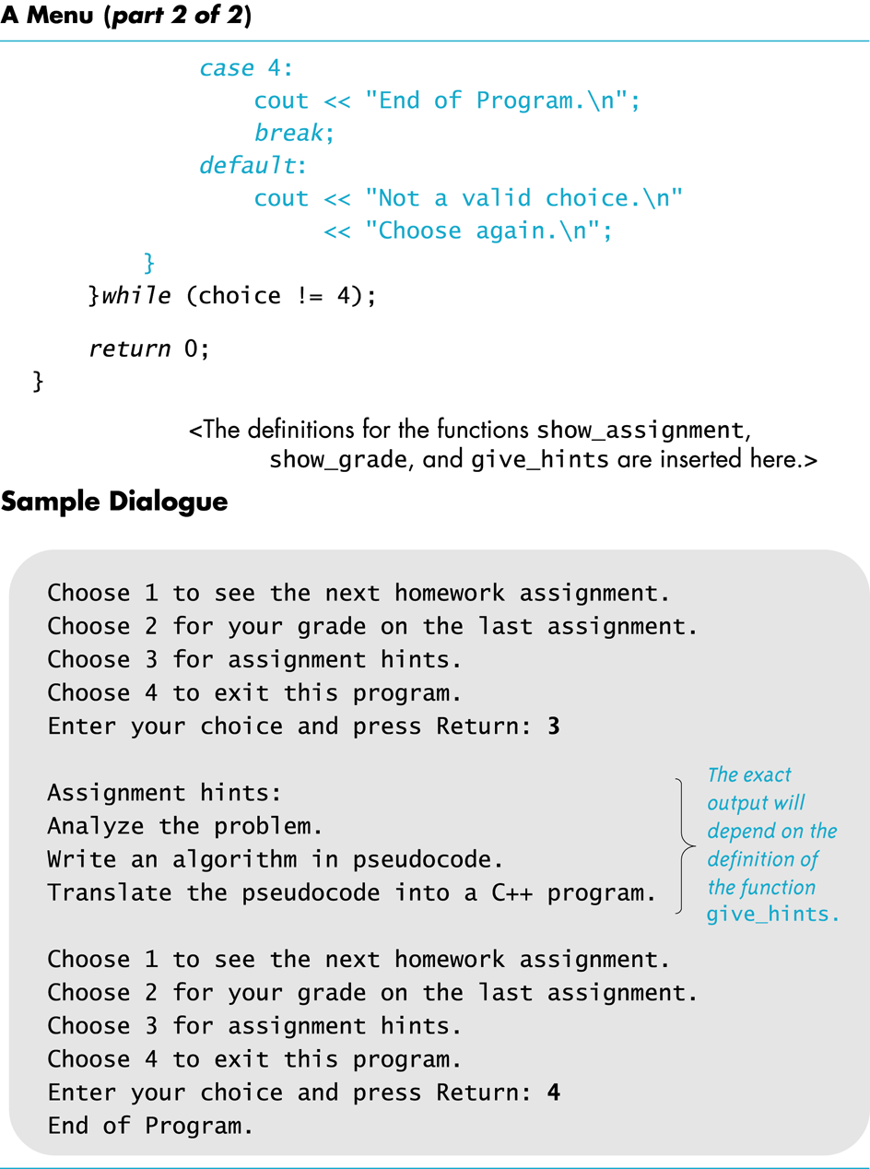
Display 3.7 (2/2)
Back
Next

Slide 110
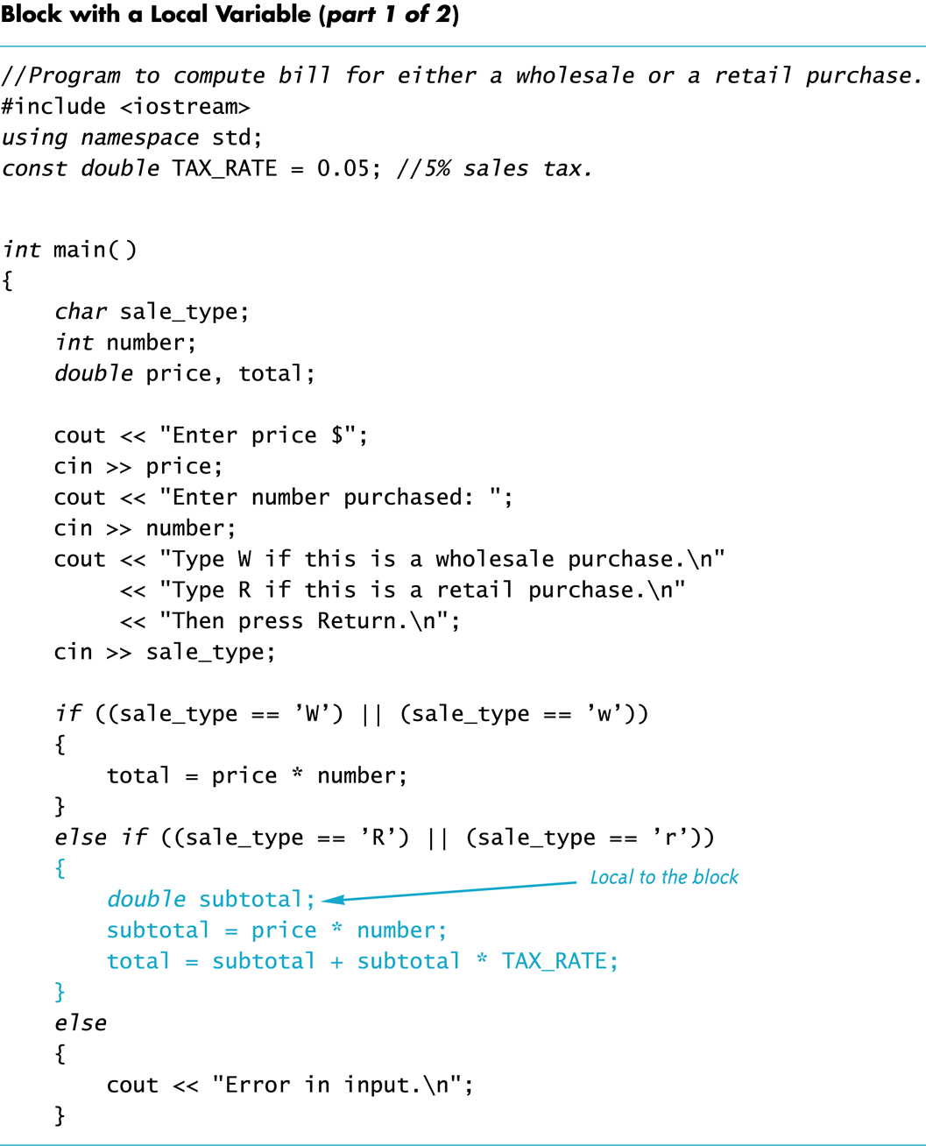
Display 3.8 (1/2)
Back
Next

Slide 111
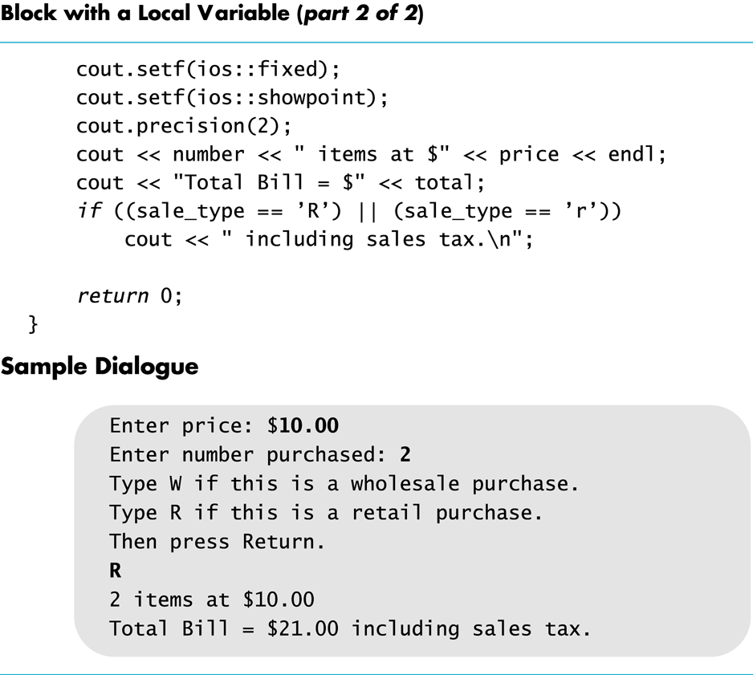
Display 3.8 (2/2)
Back
Next

Slide 112
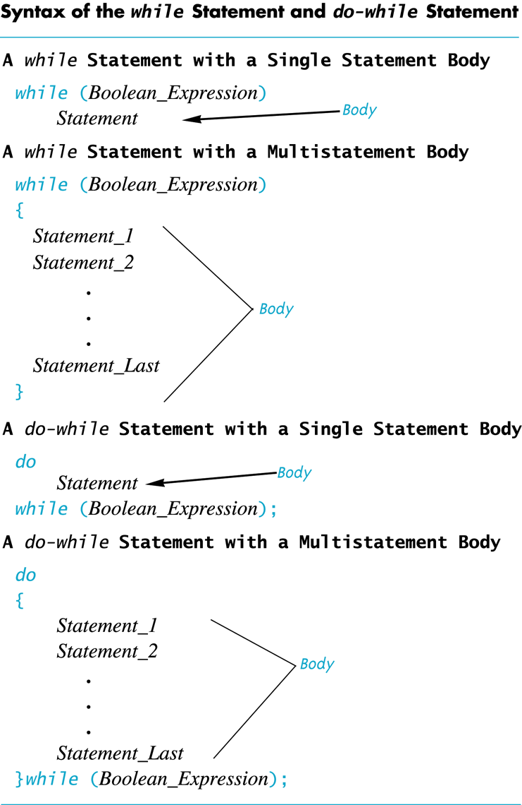
Display 3.9
Back
Next

Slide 113
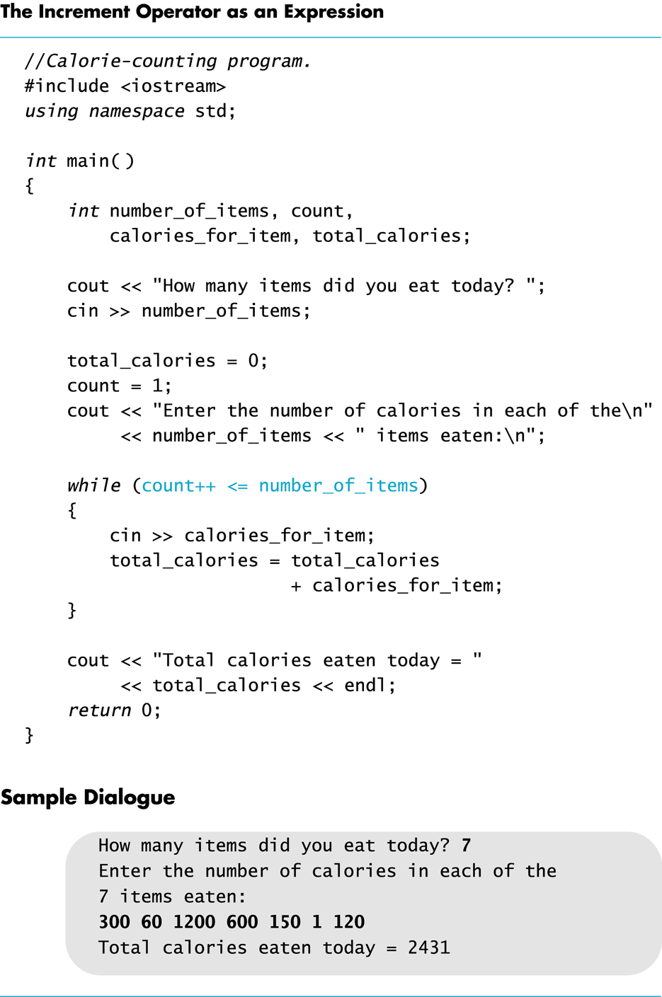
Display 3.10
Back
Next

Slide 114
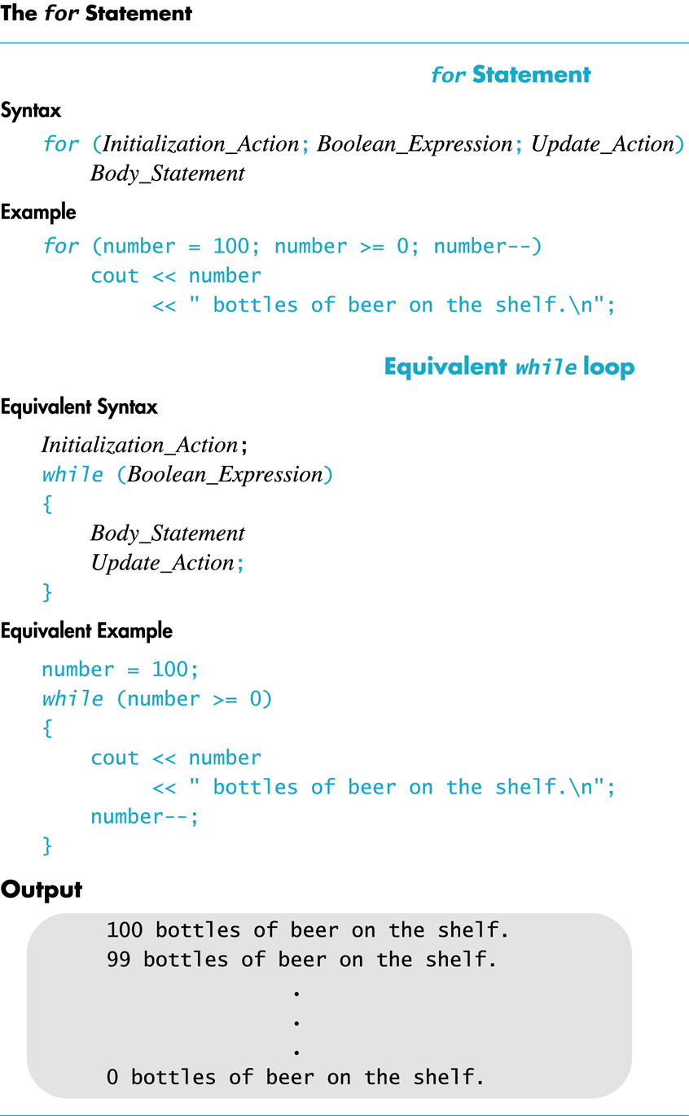
Display 3.11
Back
Next

Slide 115
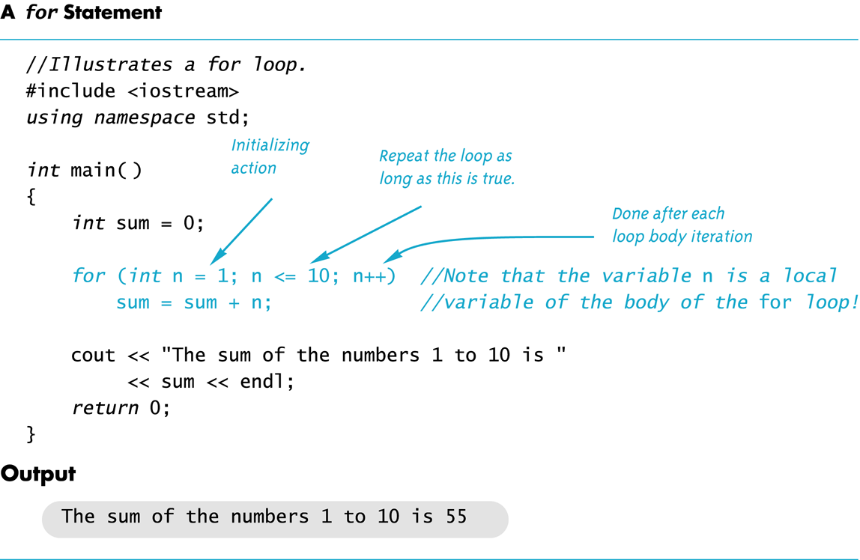
Display 3.12
Back
Next

Slide 116
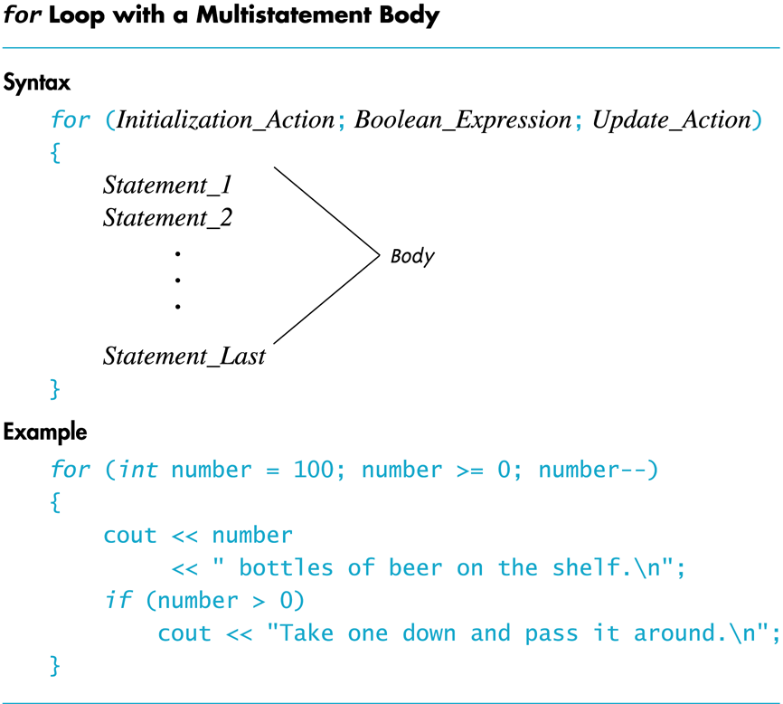
Display 3.13
Back
Next

Slide 117
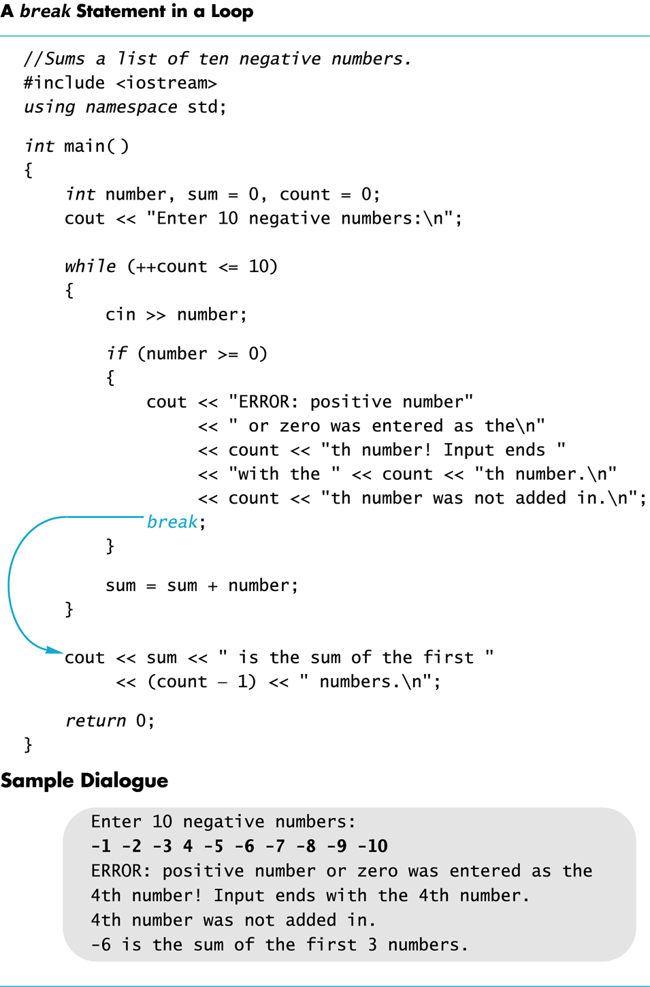
Display 3.14
Back
Next

Slide 118
Display 3.15
Back
Next
//DISPLAY 3.15 Explicitly Nested Loops
//Determines the total number of green-necked vulture eggs
//counted by all conservationists in the conservation district.
#include <iostream>
using namespace std;
int main()
{
cout << "This program tallies conservationist reports\n"
<< "on the green-necked vulture.\n"
<< "Each conservationist's report consists of\n"
<< "a list of numbers. Each number is the count of\n"
<< "the eggs observed in one "
<< "green-necked vulture nest.\n"
<< "This program then tallies "
<< "the total number of eggs.\n";
int number_of_reports;
cout << "How many conservationist reports are there? ";
cin >> number_of_reports;
int grand_total = 0, subtotal, count;
for (count = 1; count <= number_of_reports; count++)
{
cout << endl << "Enter the report of "
<< "conservationist number " << count << endl;
cout << "Enter the number of eggs in each nest.\n"
<< "Place a negative integer at the end of your list.\n";
subtotal = 0;
int next;
cin >> next;
while (next >=0)
{
subtotal = subtotal + next;
cin >> next;
}
cout << "Total egg count for conservationist "
<< " number " << count << " is "
<< subtotal << endl;
grand_total = grand_total + subtotal;
}
cout << endl << "Total egg count for all reports = "
<< grand_total << endl;
return 0;
}

